Slide 1
Vinho da ‘Ville
A Charlottesville Wine Story
Michael Kolonay - Jordan Machita - Stephen Morris - Siddharth Surapeneni

Slide 2
Agenda
Background
Executive Summary
Data Background
White Wines Analysis
Red Wines Analysis
Conclusion

Slide 3
Background - Vinho da ‘Ville
New winery planning to open next year in Charlottesville
Niche market for high quality Portuguese wine
Quality 7 or higher
Goals:
Understand and differentiate characteristics of Portuguese wine
Generate predictive model for best quality
Precision – distinguishing high quality wines
True Positive vs. False Positive

Slide 4
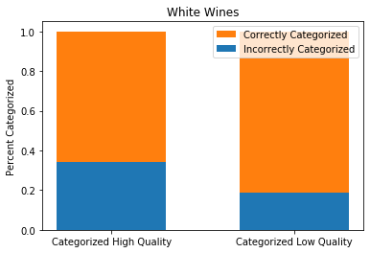
Executive Summary
White Wines
Alcohol Content (increase -> high quality)
Residual Sugars (increase -> high quality)
Chlorides (decrease -> high quality)
Density (decrease -> high quality)
White Wines
55% Threshold | Categorized as Low | Categorized as High
True Low Quality Wines | 1848 | 58
True High Quality Wines | 431 | 112
Note: Figures in green are categorized correctly; those in red are categorized incorrectly.

Slide 5
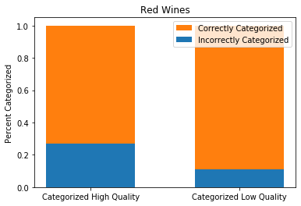
Executive Summary
Red Wines
Alcohol Content (increase -> high quality)
Sulphates (increase -> high quality)
Volatile Acidity (decrease -> high quality)
Red Wines
45% Threshold | Categorized as Low | Categorized as High
True Low Quality Wines | 676 | 11
True High Quality Wines | 83 | 30
Note: Figures in green are categorized correctly; those in red are categorized incorrectly.

Slide 6
Data Background
Source: UCI Machine Learning Repository
https://archive.ics.uci.edu/ml/datasets/wine+quality
1599 red, 4898 white wines
1 response variable: Quality
Categorical:
“High” = 7 or higher
“Low” = 6 or lower
11 predictor variables:
Alcohol
Residual Sugars
Density
Total Sulphur Dioxide
Free Sulphur Dioxide
Sulphates
Fixed Acidity
Volatile Acidity
Citric Acid
Chlorides
pH

Slide 7
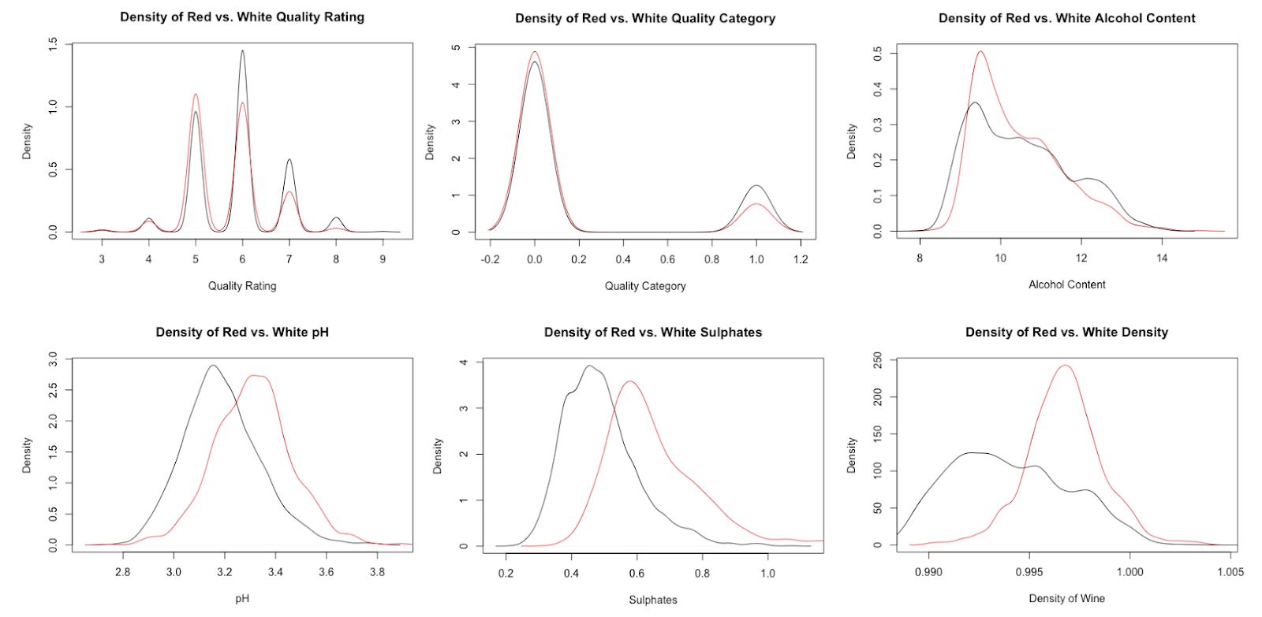
Data Background

Slide 8
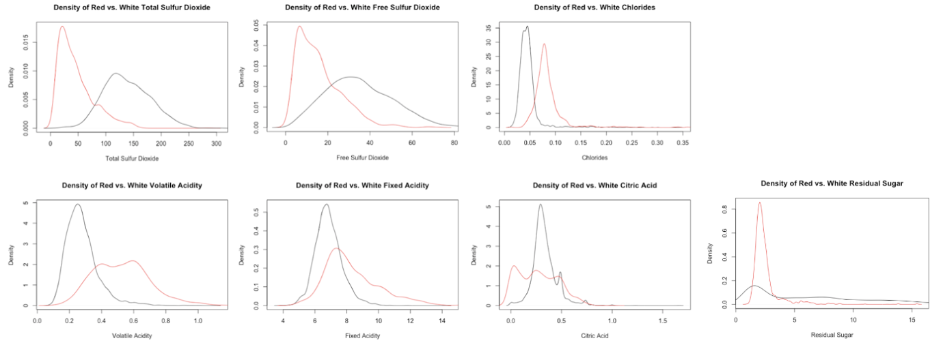
Data Background

Slide 9
Data Background

Slide 10
White Wines – Exploratory data Analysis
4898 wines:
1060 high quality
3838 low quality
Goal:
Predict high quality wines
Minimize false positives

Slide 11
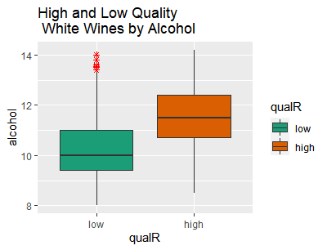
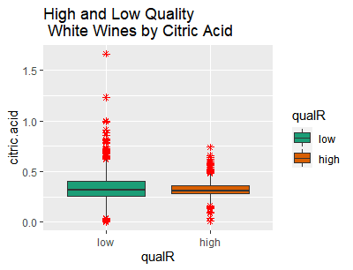
White Wines – Exploratory data Analysis
Boxplots of Alcohol and Citric Acid by Quality

Slide 12
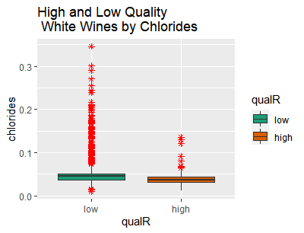
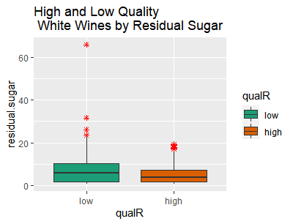
White Wines – Exploratory data Analysis
Boxplots of Chlorides and Residual Sugar by Quality

Slide 13
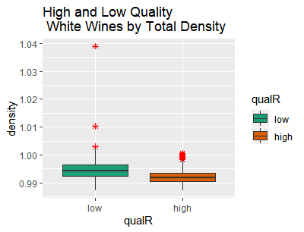
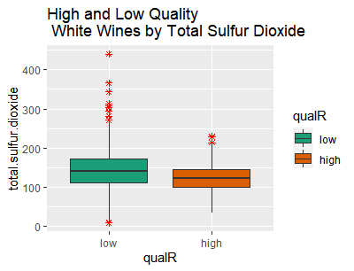
White Wines – Exploratory data Analysis
Boxplots of Density and Total Sulfur Dioxide by Quality

Slide 14
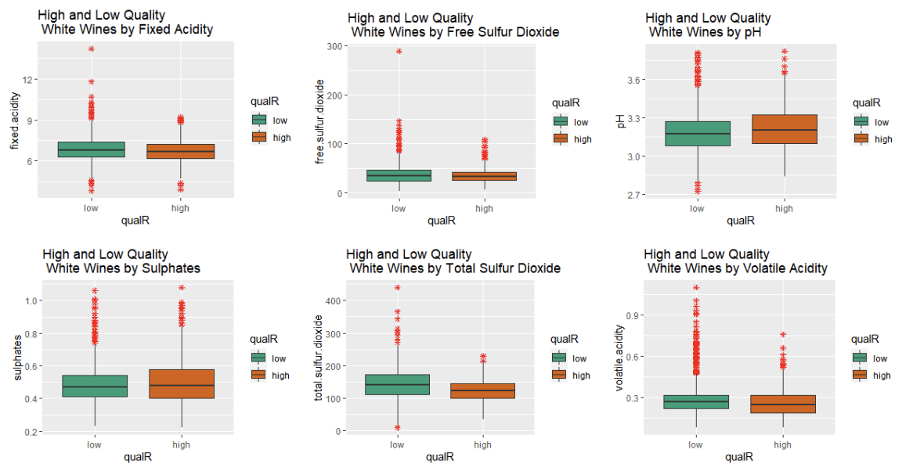
White Wines – Exploratory data Analysis
Boxplots of Remaining Predictors by Quality

Slide 15
White Wines – Detailed Analysis
2 methods:
Full model, backward elimination
EDA predictors, backward elimination
Comparison of Method 1 and 2 Results:
Model | Threshold | Confusion | Sensitivity | Specificity | Accuracy | Precision
Method 1: Full | .55 | FALSE TRUE 0 1833 73 1 422 121 | 0.2228361 | 0.9616999 | 0.7978767 | 0.6237113
Method 2: EDA | .55 | FALSE TRUE 0 1848 58 1 431 112 | 0.2062615 | 0.9695698 | 0.8003267 | 0.6588235

Slide 16
White Wines – Detailed Analysis
Method 1: Full model, backward elimination
Step | AUC | Confusion(.5) | Sensitivity | Specificity | Accuracy | Precision | dropped
0 | 0.7939588 | FALSE TRUE 0 1819 98 1 388 144 | 0.270677 | 0.9488785 | 0.801552 | 0.5827338
1 | 0.7939153 | FALSE TRUE 0 1789 117 1 381 162 | 0.298343 | 0.9386149 | 0.796652 | 0.5806452 | alcohol
2 | 0.7937192 | FALSE TRUE 0 1790 116 1 376 167 | 0.307551 | 0.9391396 | 0.799102 | .590106 | citric.acid
3 | 0.7943926 | FALSE TRUE 0 1789 117 1 376 167 | 0.307551 | 0.9386149 | 0.798693 | 0.5880282 | Total Sulfur dioxide

Slide 17
White Wines – Detailed Analysis
Method 1: Full model, backward elimination
Model Summary
 | Estimate | Std. Error | z value | Pr(>|z|)
(Intercept) | 7.33E+02 | 4.83E+01 | 15.167 | < 2e-16 ***
fixed.acidity | 6.36E-01 | 9.06E-02 | 7.015 | 2.31e-12 ***
volatile.acidity | -3.22E+00 | 6.31E-01 | -5.101 | 3.38e-07 ***
residual.sugar | 3.44E-01 | 2.74E-02 | 12.56 | < 2e-16 ***
chlorides | -1.67E+01 | 5.44E+00 | -3.075 | 0.0021 **
free.sulfur.dioxide | 6.58E-03 | 3.27E-03 | 2.013 | 0.0441 *
density | -7.57E+02 | 4.99E+01 | -15.183 | < 2e-16 ***
pH | 3.70E+00 | 4.74E-01 | 7.81 | 5.70e-15 ***
sulphates | 2.17E+00 | 4.70E-01 | 4.617 | 3.88e-06 ***

Slide 18
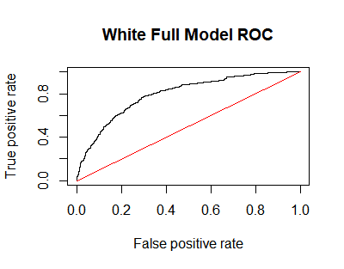
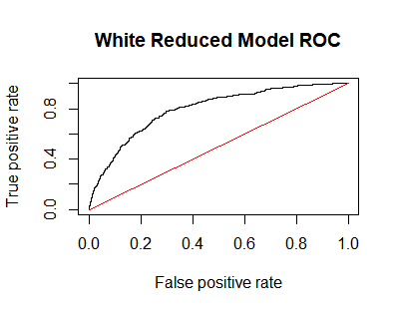
White Wines – Detailed Analysis
Method 1: Full model, backward elimination
Threshold | Confusion | Sensitivity | Specificity | Accuracy | Precision
.5 | FALSE TRUE 0 1789 117 1 376 167 | 0.3075506 | 0.9386149 | 0.7986933 | 0.5880282
.55 | FALSE TRUE 0 1833 73 1 422 121 | 0.2228361 | 0.9616999 | 0.7978767 | 0.6237113
.60 | FALSE TRUE 0 1863 43 1 451 92 | 0.1694291 | 0.9774397 | 0.798285 | 0.6814815

Slide 19
White Wines – Detailed Analysis
Method 2: EDA predictors, backward elimination
Begins with alcohol, citric acid, residual sugar, chlorides, total sulfur dioxide, and density
Step | AUC | Confusion(.5) | Sensitivity | Specificity | Accuracy | Precision | dropped
0 | 0.7572742 | FALSE TRUE 0 1804 102 1 391 152 | 0.279926 | 0.9464848 | 0.798693 | 0.5984252
1 | 0.7573061 | FALSE TRUE 0 1805 101 1 390 153 | 0.281768 | 0.9470094 | 0.79951 | 0.6023622 | citric acid
2 | 0.7581912 | FALSE TRUE 0 1806 100 1 390 153 | 0.281768 | 0.9475341 | 0.799918 | 0.6047431 | total sulfur dioxide
3 | 0.7576863 | FALSE TRUE 0 1802 104 1 382 161 | 0.296501 | 0.9454355 | 0.801552 | 0.6075472 | density

Slide 20
White Wines – Detailed Analysis
Method 2: EDA predictors, backward elimination
Model Summary
 | Estimate Std. | Error | z value | Pr(>|z|)
(Intercept) | 114.6922 | 70.02613 | 1.638 | 0.101453
alcohol | 0.59823 | 0.10116 | 5.914 | 3.34e-09 ***
residual.sugar | 0.09231 | 0.02717 | 3.398 | 0.000680 ***
chlorides | -20.31611 | 5.23858 | -3.878 | 0.000105 ***
density | -122.94871 | 69.73427 | -1.763 | 0.077883 .

Slide 21
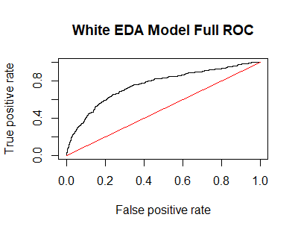
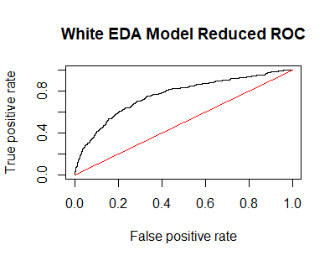
White Wines – Detailed Analysis
Method 2: EDA predictors, backward elimination
Threshold | Confusion | Sensitivity | Specificity | Accuracy | Precision
.5 | FALSE TRUE 0 1806 100 1 390 153 | 0.281768 | 0.9475341 | 0.7999183 | 0.6047431
.55 | FALSE TRUE 0 1848 58 1 431 112 | 0.2062615 | 0.9695698 | 0.8003267 | 0.6588235

Slide 22
White Wines – Summary
Full model, backward elimination
Fixed acidity, volatile acidity, residual sugars, chlorides, free sulfur dioxide, density, pH, sulphates
EDA predictors, backward elimination
Alcohol, residual sugars, chlorides, density
Model | Threshold | Confusion | Sensitivity | Specificity | Accuracy | Precision
Method 1: Full | .55 | FALSE TRUE 0 1833 73 1 422 121 | 0.2228361 | 0.9616999 | 0.7978767 | 0.6237113
Method 2: EDA | .55 | FALSE TRUE 0 1848 58 1 431 112 | 0.2062615 | 0.9695698 | 0.8003267 | 0.6588235

Slide 23
Red Wines – Exploratory data Analysis
1599 wines:
113 high quality
687 low quality
Goal:
Predict high quality wines
Minimize false positives

Slide 24
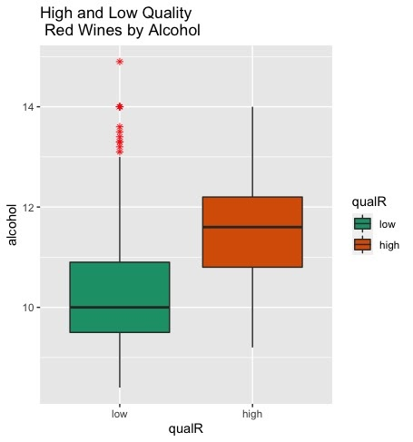
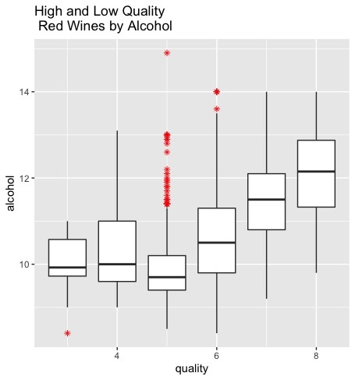
red Wines – Exploratory data Analysis
Boxplots of Alcohol by Quality

Slide 25
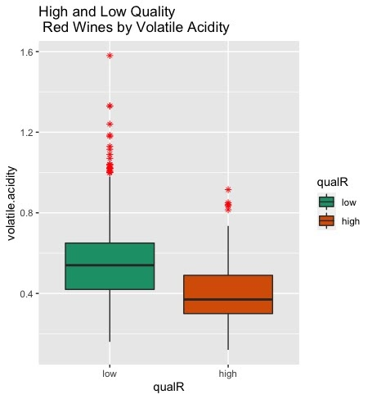
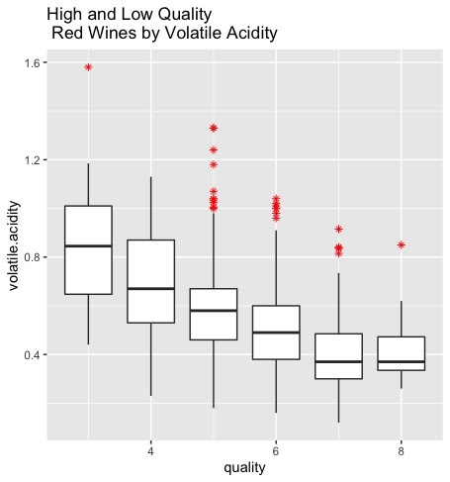
red Wines – Exploratory data Analysis
Boxplots of Volatile Acidity by Quality

Slide 26
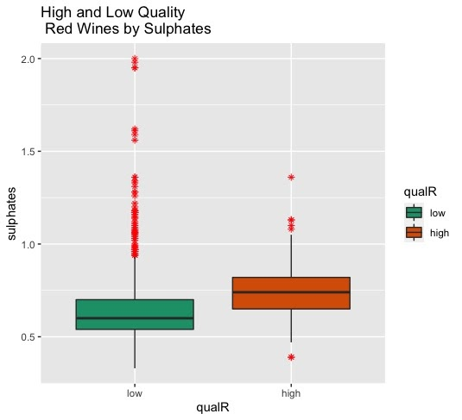
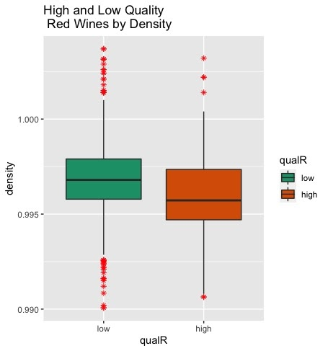
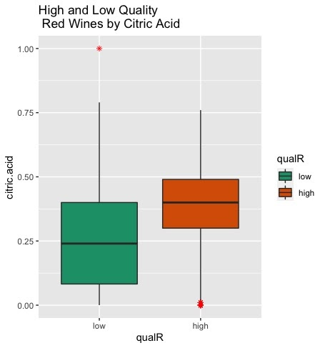
red Wines – Exploratory data Analysis
Boxplots of Sulphates, Density, and Citric Acid by Quality

Slide 27
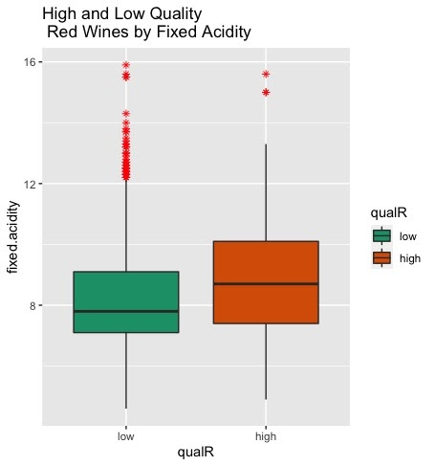
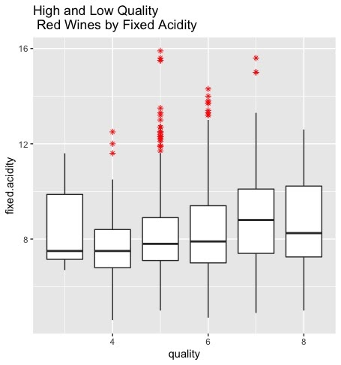
red Wines – Exploratory data Analysis
Boxplots of Fixed Acidity by Quality

Slide 28
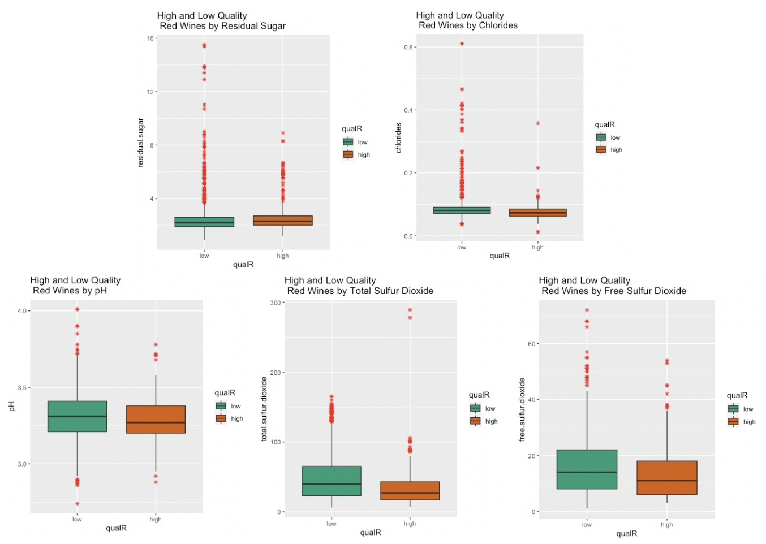
red Wines – Exploratory data Analysis
Boxplots of Remaining Predictors by Quality

Slide 29
red Wines – Detailed Analysis
3 methods:
Full model, backward elimination
EDA predictors, backward elimination
Adjusted version of (2), revisiting EDA
Comparison of Method 1, 2, and 3 Results:
Model | Threshold | Confusion | Sensitivity | Specificity | Accuracy | Precision
Method 1: Full | .50 | FALSE TRUE 0 669 18 1 79 34 | 0.3008 | 0.973 | 0.87875 | 0.6538
Method 2: EDA | .50 | FALSE TRUE 0 679 8 1 90 23 | 0.2035 | 0.9884 | 0.8775 | 0.7419355
Method 3: EDA Adjusted | 0.45 | FALSE TRUE 0 676 11 1 83 30 | 0.2655 | 0.98399 | 0.8825 | 0.7317

Slide 30
red Wines – Detailed Analysis
Method 1: Full model, backward elimination
Step | AUC | Confusion(.5) | Sensitivity | Specificity | Accuracy | Precision | dropped
0 | 0.8902758 | FALSE TRUE 0 672 15 1 76 37 | 0.3274336 | 0.9781659 | 0.88625 | 0.7115385
1 | 0.8902629 | FALSE TRUE 0 672 15 1 77 36 | 0.3185841 | 0.9781659 | 0.885 | 0.7058824 | pH
2 | 0.8900826 | FALSE TRUE 0 672 15 1 77 36 | 0.3185841 | 0.9753266 | 0.885 | 0.7058824 | free sulfur dioxide
3 | 0.8914222 | FALSE TRUE 0 673 14 1 77 36 | 0.3185841 | 0.9796215 | 0.88625 | 0.72 | citric acid
4 | 0.8895802 | FALSE TRUE 0 669 18 1 79 34 | 0.300885 | 0.9737991 | 0.87875 | 0.6538462 | density

Slide 31
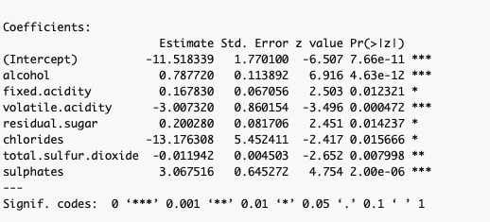
red Wines – Detailed Analysis
Method 1: Full model, backward elimination

Slide 32
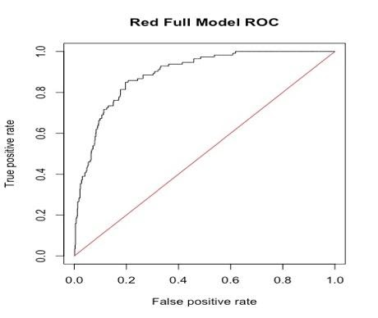
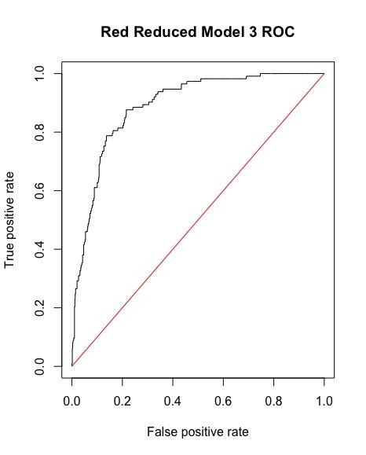
red Wines – Detailed Analysis
Method 1: Full model, backward elimination
Threshold | Confusion | Sensitivity | Specificity | Accuracy | Precision
.55 | FALSE TRUE 0 678 9 1 87 26 | 0.2300885 | 0.9868996 | 0.88 | 0.7428571
.50 | FALSE TRUE 0 669 18 1 79 34 | 0.3008 | 0.973 | 0.87875 | 0.6538
.45 | FALSE TRUE 0 662 25 1 75 38 | 0.3362832 | 0.9636099 | 0.875 | 0.6031746

Slide 33
red Wines – Detailed Analysis
Method 2: EDA predictors, backward elimination
Begins with Alcohol, Volatile Acidity, Citric Acid, Density, and Sulphates
Step | AUC | Confusion(.5) | Sensitivity | Specificity | Accuracy | Precision | dropped
0 | 0.8839768 | FALSE TRUE 0 678 9 1 91 22 | 0.1946 | 0.9869 | 0.875 | 0.7096774
1 | 0.8840541 | FALSE TRUE 0 679 8 1 90 23 | 0.2035 | 0.9884 | 0.8775 | 0.7419355 | density

Slide 34
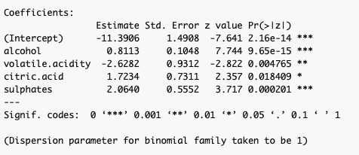
red Wines – Detailed Analysis
Method 2: EDA predictors, backward elimination

Slide 35
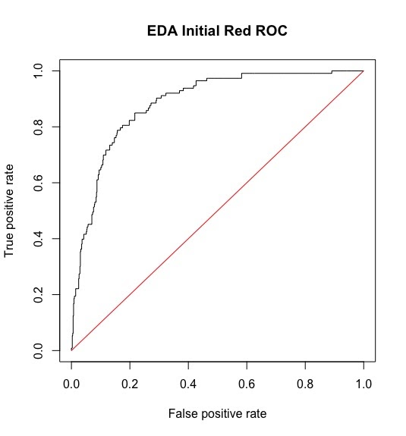

red Wines – Detailed Analysis
Method 2: EDA predictors, backward elimination
Threshold | Confusion | Sensitivity | Specificity | Accuracy | Precision
.55 | FALSE TRUE 0 683 4 1 95 18 | 0.15929 | 0.99417 | 0.875 | 0.8181
.50 | FALSE TRUE 0 679 8 1 90 23 | 0.20353 | 0.9884 | 0.8775 | 0.7419355
.45 | FALSE TRUE 0 670 17 1 86 27 | 0.238938 | 0.9752547 | 0.87125 | 0.613636

Slide 36
red Wines – Detailed Analysis
Method 3: Adjusted EDA predictors, backward elimination
Begins with Alcohol, Volatile Acidity, Density, Sulphates, and Residual Sugars
Step | AUC | Confusion(.5) | Sensitivity | Specificity | Accuracy | Precision | dropped
0 | 0.8855741 | FALSE TRUE 0 680 7 1 91 22 | 0.2300885 | 0.9898108 | 0.8775 | 0.7586207
1 | 0.88645 | FALSE TRUE 0 682 5 1 92 21 | 0.1858407 | 0.992722 | 0.87875 | 0.8076923 | density
2 | 0.8874934 | FALSE TRUE 0 682 5 1 94 19 | 0.1681416 | 0.992722 | 0.87625 | 0.7916667 | residual sugar

Slide 37
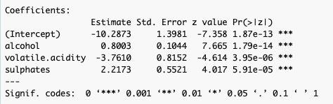
red Wines – Detailed Analysis
Method 3: Adjusted EDA predictors, backward elimination

Slide 38
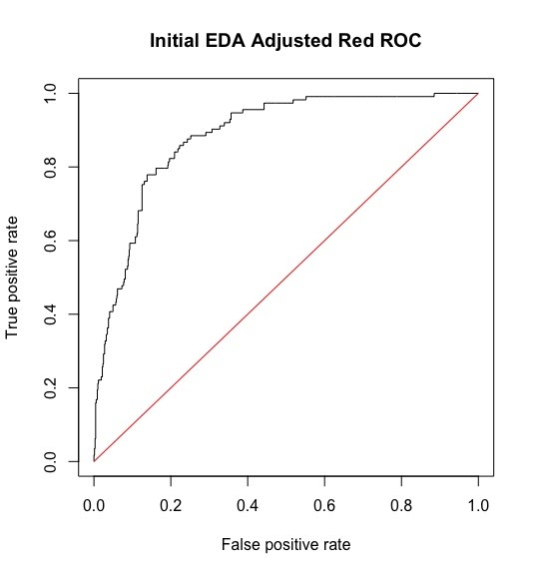
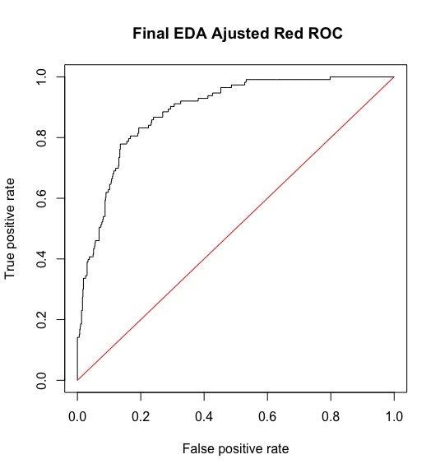
red Wines – Detailed Analysis
Method 3: Adjusted EDA predictors, backward elimination
Threshold | Confusion | Sensitivity | Specificity | Accuracy | Precision
0.45 | FALSE TRUE 0 676 11 1 83 30 | 0.2655 | 0.98399 | 0.8825 | 0.7317
0.50 | FALSE TRUE 0 682 5 1 94 19 | 0.1681416 | 0.992722 | 0.87625 | 0.7916667
0.55 | FALSE TRUE 0 685 2 1 97 16 | 0.1416 | 0.997 | 0.87625 | 0.888

Slide 39
red Wines – Detailed Analysis
Full model, backward elimination
Alcohol, volatile acidity, sulphates, fixed acidity, residual sugar, chlorides, total sulfur dioxide
EDA predictors, backward elimination
Alcohol, volatile acidity, citric acid, sulphates
Adjusted version of (2), revisiting EDA
Alcohol, volatile acidity, sulphates
Model | Threshold | Confusion | Sensitivity | Specificity | Accuracy | Precision
Method 1: Full | .50 | FALSE TRUE 0 669 18 1 79 34 | 0.3008 | 0.973 | 0.87875 | 0.6538
Method 2: EDA | .50 | FALSE TRUE 0 679 8 1 90 23 | 0.2035 | 0.9884 | 0.8775 | 0.7419355
Method 3: EDA Adjusted | 0.45 | FALSE TRUE 0 676 11 1 83 30 | 0.2655 | 0.98399 | 0.8825 | 0.7317

Slide 40
Conclusion
EDA yielded better predictive models than starting with full models
Thresholds optimized for precision while balancing sensitivity to maintain a sufficient population of wines
Final Results:
Type | Predictors | Threshold | Confusion | Sensitivity | Specificity | Accuracy | Precision
White | Alcohol Residual Sugar Chlorides Density | .55 | FALSE TRUE 0 1848 58 1 431 112 | 0.2062615 | 0.9695698 | 0.8003267 | 0.658823
Red | Alcohol Volatile Acidity Sulphates | .45 | FALSE TRUE 0 676 11 1 83 30 | 0.2654867 | 0.9839884 | 0.8825 | 0.731707

